Slide 1

Crimes In San Francisco
By-
Sameer Darekar and Rohit Dandona

Slide 2
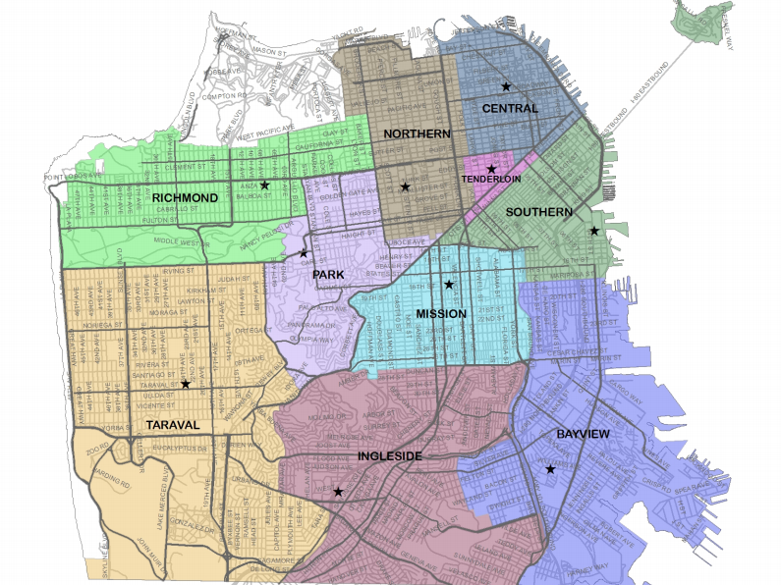
Objective
Reduce the Crime in San Francisco
Help the SFPD to find Patterns in Crime
Help them to manage the troops and patrol vehicles
Help the people to find out high prone crime areas
Anything else?

Slide 3
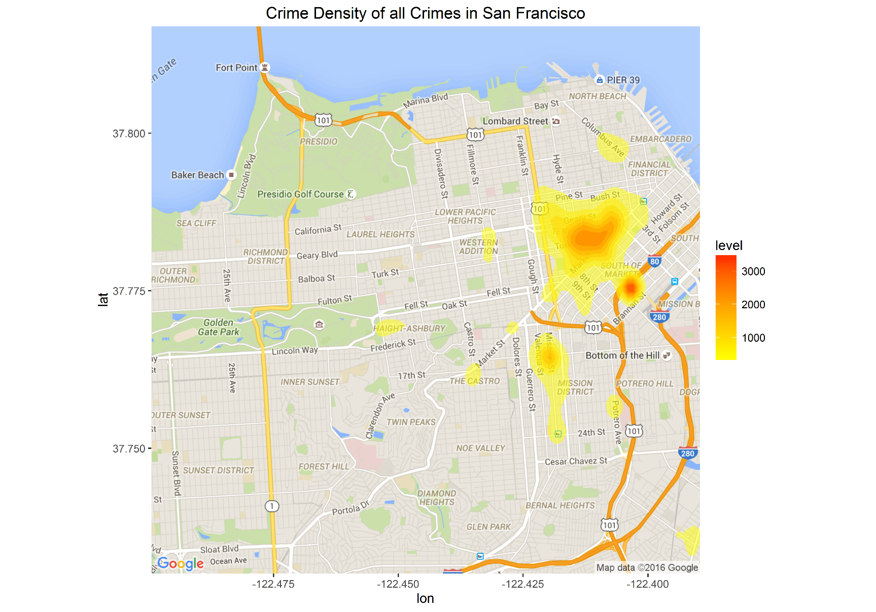
Overall Crime Scenario
+ bar graph or Pie chart of all crimes

Slide 4
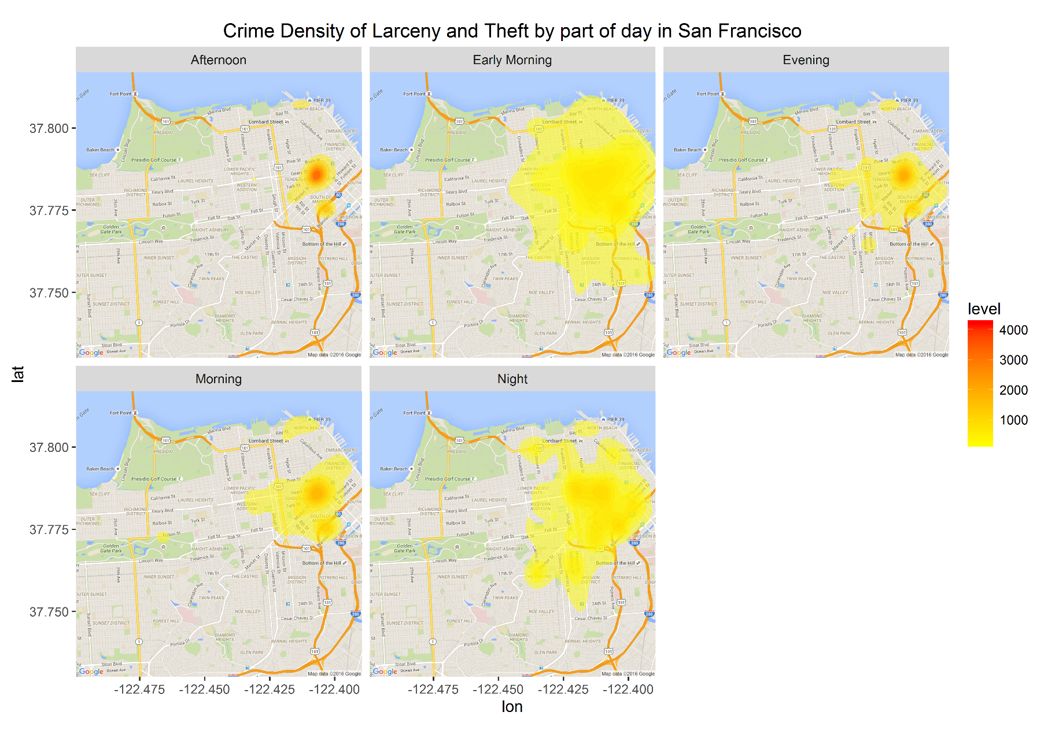
Distribution of Larceny and theft by Time
+ bar graph of all crimes by time

Slide 5
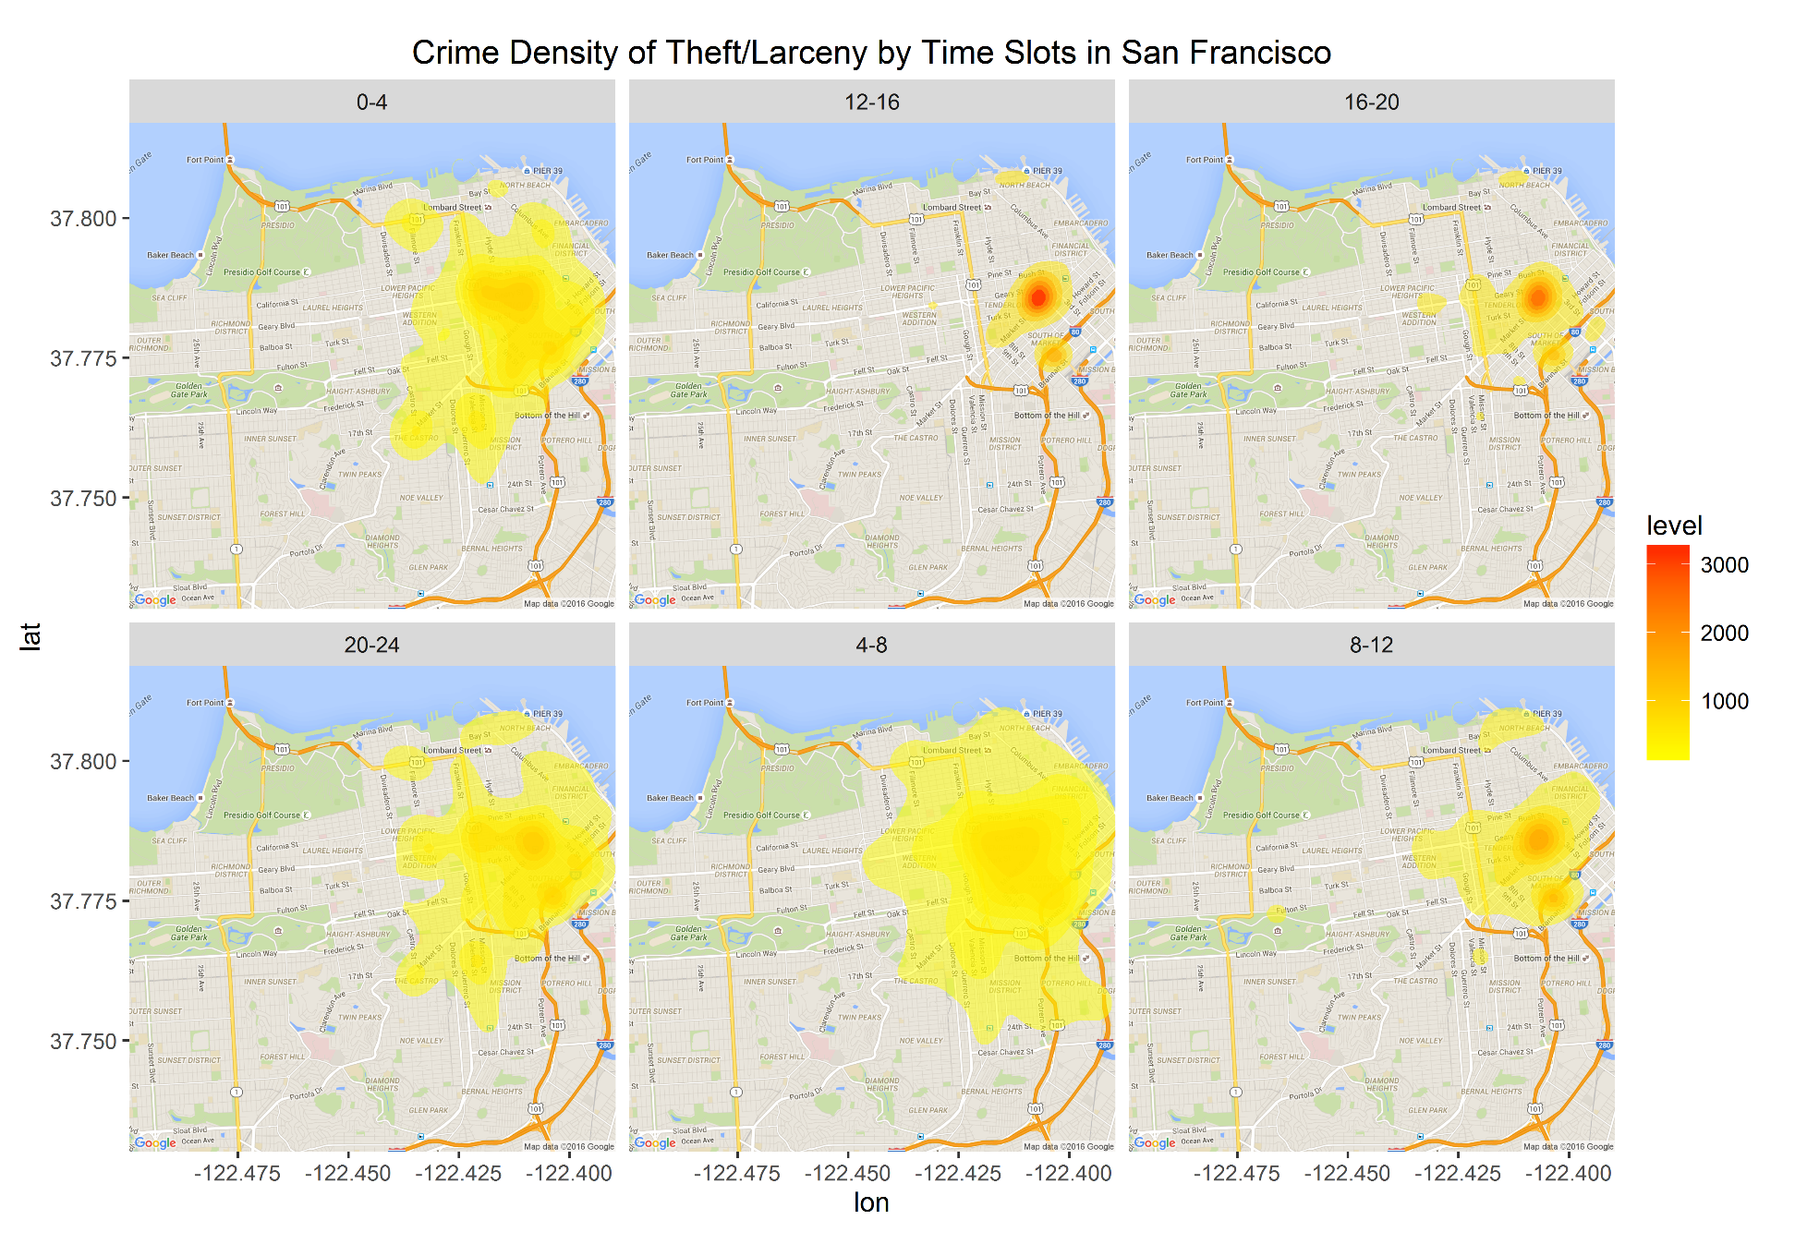
Distribution of Theft Crime by Time
+ bar graph of all crimes by time

Slide 6
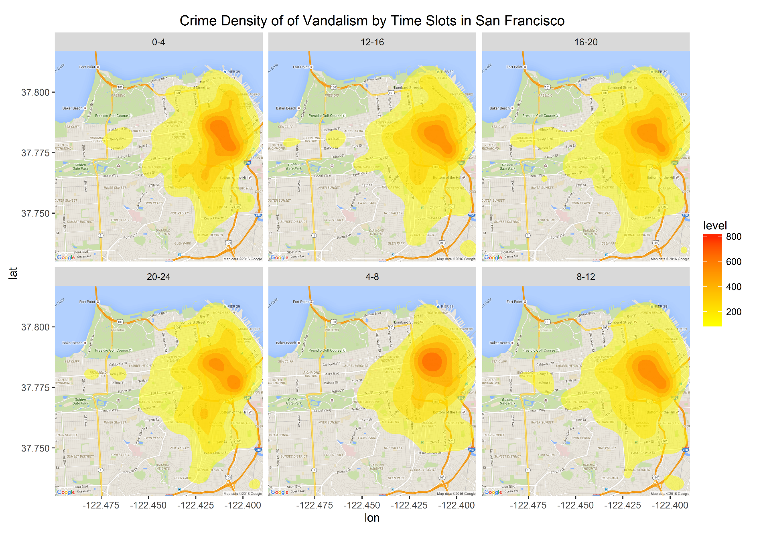
Distribution of Vandalism by Time
+ bar graph of all crimes by time

Slide 7
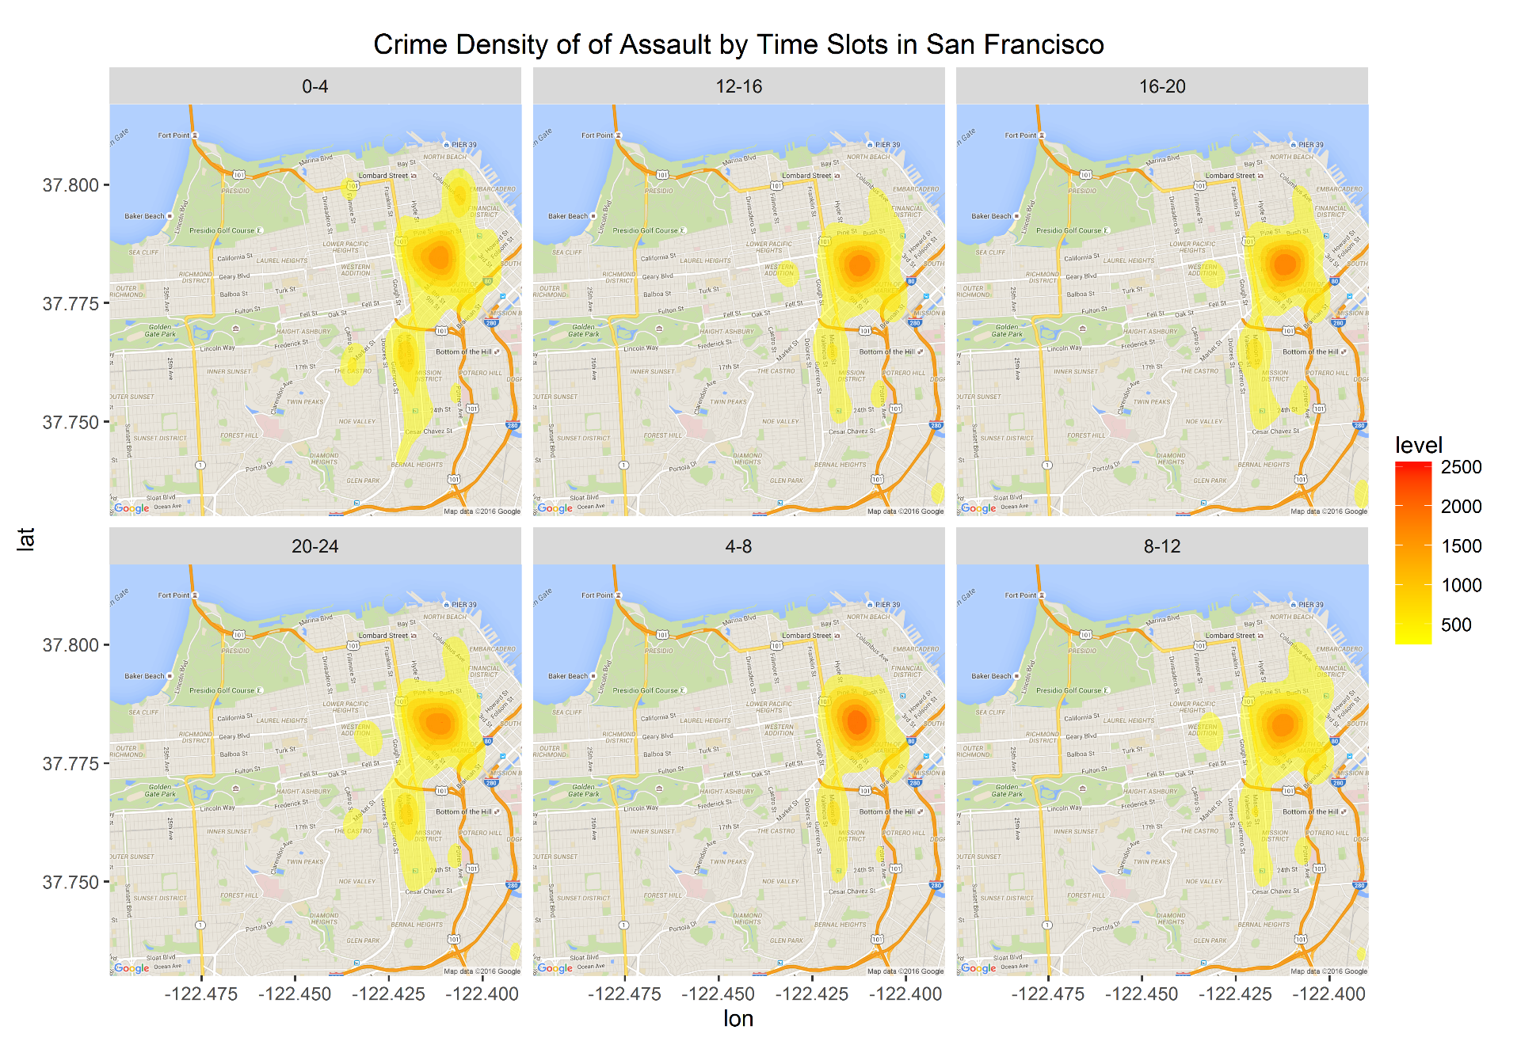
Distribution of Assault by Time
+ bar graph of all crimes by time

